Slide 1
Training Program for Section Officers at the Staff College
Topic: Correspondence in English
Theoretical understanding and
Practice of writing
  Personal & Official Business Correspondence
-Ram Babu Dhakal
Fmr. Under-Secretary, MoFA
December 28, 2018

Slide 2
Definition
Correspondence: communication by letters
International correspondence in English language
Diplomatic correspondence: Communication through diplomatic channels, in other words, diplomatic documents as well.
If long-term intentions are not communicated clearly to both friends and adversaries the consequences can be disastrous." (Harold Nicolson)

Slide 3
Purposes
Communication to the counterpart (person or agency): letter/note verbale
Communication to public (ordinary) and media (news persons/ agencies) through oral statement (interview) or printed/electronic version: press release/press note/communiqué.
Message for souvenir/book/publication
Invitation for an official meeting
Taking notes on meeting.
First person correspondence
Third person correspondence

Slide 4
Types of letters in General
Personal (family, friends, children, introduction, love letters)
Social (greetings, condolences, congratulations)
Matrimonial (marriage, after marriage, divorce)
Employment ( notices, replies, appointment)
Commercial (business queries, circulars)
Public (letter to the editor, leaders, club)
Legal (receipt, telegram, Affidavit, lawyers)
Official (complaints, enquiries, notice, diplomatic)
Others (literary, publishers, article)

Slide 5
Types of Official Correspondence
Types of Diplomatic Note (Correspondence):
  Third Person Note (Note Verbale, Circular Diplomatic Note (identical note), Note Diplomatique, Aide-Mémoire, Note Collective, Memorandum)
  First Person Letter : Ambassador, Minister, Secretary.
Multitude of purpose:
  Request note
  Reply note (Response Note)
  Protest Note
  Invitation
  Exchange of notes : Constituting a part of treaty/ an international agreement

Slide 6
Paper Size for Notes
The US Department of State has developed a Foreign Affairs Handbook on diplomatic note writing. It prescribes the paper size.
For example, "for the first-person formal note, preparers must use the (8-1/2” x 11” embossed white seal “Department of State Washington” diplomatic note stationery) or "Embassy of the United States of America" letterhead. For succeeding (8-1/2” x 11”) white bond paper must be used." (Vol.5, HB 1)
"The first page of the third-person note is prepared on 8-1/2” x 11” embossed white seal diplomatic note stationery. For succeeding pages, 8-1/2” x 11”white bond paper is used."

Slide 7
Introduction to Samples
Address and Date
xx
Salutation
(Dear Sir, Madam, Mr./Ms….)
Xx
Body of the letter
Xx
Salutory Close
Yours sincerely/truly/faithfully
Signature
Name and address of the receiving person

Slide 8
Example of Styles Used for Note/Letter
See examples of notes used in our practice during the discussion.
Channel of communication to foreign governments is MOFA.
All communications are in English.
Designations, titles and names of dignitaries are to be checked for accuracy.
First/second person pronouns, i.e., you and I, are used in first person note, but not in the third person note.
Third person pronouns, i.e., he, she, it, they, are used in third person note. Don't use the courtesy phrase, "Your Excellency," in the third person note, it should be used in first person note when first mentioned. To avoid repetition, "you" or "your" should be used in subsequent reference.

Slide 9
Courtesy Phrases
"I have the honour" is used in the first person letter when an ambassador, prime minister, minister for foreign affairs and secretary is being addressed.
Salutation on the first person note : "Excellency" to ambassador, minister for foreign affairs, foreign secretary. "Sir" or "Madam" for others such as CDA, a.i.
The courtesy phrase "has the honour" is used in the third person note.
The dateline is placed at the end the text on the third person note. Like, Kathmandu, December 4, 2011. The date is written above the salutation and text on the first person note.
The third person note may be from the minister for foreign affairs or foreign secretary to ambassadors or heads of mission. The letter from these dignitaries could be in the first person as well depending on the subject matter and intent in what mode to communicate.

Slide 10
Closing clause and others related to style
Closing and signature : The clause "Accept, Excellency, the assurances of my highest consideration" is used on the first person note for ambassador, secretary and minister for foreign affairs. "Accept, Sir (Madam), the assurances of my highest consideration." for CDA, a.i. and others.
"The Ministry of…./or Embassy of…avails itself this opportunity to renew to the Ministry of…/or Embassy of…. the assurances of its highest consideration." is written on the third person note as a closing sentence.
Reply must be in the same form as received.
Numbering the notes follows the local custom, for example, the US DOS does not number the note while their embassies do.
Spelling must be checked.
Subject + verb+ object must be matched.

Slide 11
Sample of Third Person Note
Crest Letter Head
No.
The Embassy of Nepal in Tokyo, Japan presents its compliments to the Ministry of Foreign Affairs, Government of Japan and has the honour to inform the esteemed Ministry that the Minister for Foreign Affairs of the Government of Nepal Hon'ble ……accompanied by few high ranking officials from the Ministry (MOFA) would like to visit Tokyo, Japan effective from December 12-15, 2018 to exchange notes on bilateral matters covering the entire gamut of pertinent and topical issues on mutual co-operation exclusively with a view to promoting and expanding the already happily existing friendly and cordial Nepal-Japan relations.
The Embassy of Nepal does expect an early communication to this effect from the Ministry of Foreign Affairs, Government of Japan.
The Embassy of Nepal in Tokyo avails itself of this opportunity to renew to the Ministry of Foreign Affairs, Government of Japan the assurances of its highest consideration.
Tokyo, Date…….
(Seal and signature)
The Ministry of Foreign Affairs
Government of Japan
Tokyo

Slide 12
Writing Exercise 1 :
Third Person Note
Suppose that you are working as a LabourAttach'e at the Embassy of Nepal in the State of Qatar. In absence of other diplomats at the Embassy you are supposed to send a Third Person Note to the Ministry of Foreign Affairs of the State of Qatar informing them of the desire of the Minister for Labour of Nepal to visit Qatar within seven days. You are also supposed to seek an appointment for a meeting between the two Labour Ministers in the Note.
Please draft a Third Person Note to be sent to the Ministry of Foreign Affairs of the State of Qatar depending on the above information.

Slide 13
Sample of First Person
In the letter of the dignitary concerned (e.g., Minister for Foreign Affairs/Foreign Secretary), crest, date, content, signature, addressed dignitary's name, address.
Begin with "Excellency…….
" I have the honour to recall………"
End with the greeting, e.g., "Please accept the excellency the assurances of my highest consideration."
On the right margin side, name in bracket with designation and signature.
On the left side, the addressed authority's name, designation and address.

Slide 14
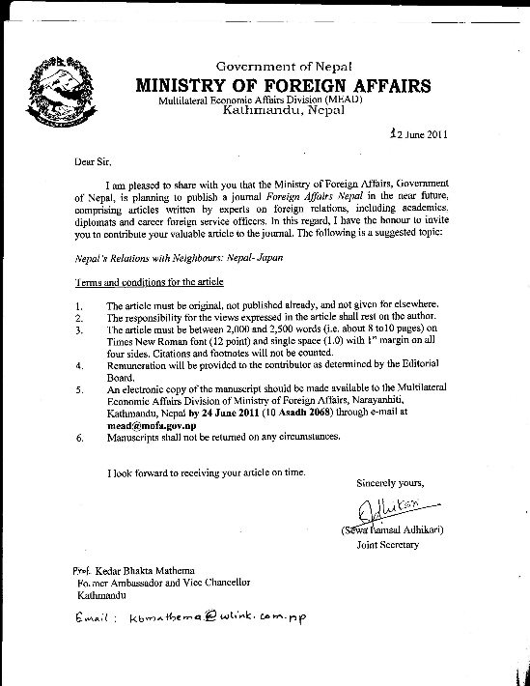
First Person Letter Sample

Slide 15
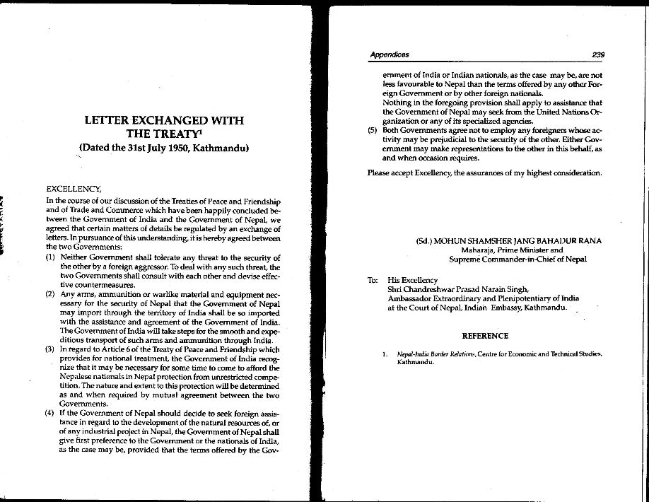
Exchange of Letters Sample
Source: SC Bhatt, India Nepal China (1996)

Slide 16
Writing Exercise 2: First Person Letter
You are working at the Ministry of Commerce and Supplies in the capacity of Section Officer. Please draft a First Person Note for the Commerce Secretary to be sent to the Director General of the WTO thanking him for the recent decision to extend technical cooperation under 'Aid for Trade' and 'Enhanced Integrated Framework' to Nepal.

Slide 17
Writing Exercise 3: FP Letter
Imagine that you are deputed at the Ministry of Health. You are aware that the Government of Nepal has been implementing "Golden One Thousand Days" campaignin collaboration with the UNICEF and the EU to overcome the challenges of stunting and malnutrition including reduction in infant/materenal mortality rate. This campaign has been instrumental in improving the child and maternal health by reducing malnutrition.
In the above backdrop, draft a 'Thank You'letter to the Executive Director of the UNICEF for UNICEF's support to the Ministry to implement the programs to provide adequate of nutrition to the mother and the child to save them from stunting.

Slide 18
Writing Exercise 4: FP Letter
Assume that you have been deputed at the Immigration Office, Rasuwagadhi. As soon as you took up your duty, you came to know that movement of illegal traders, smugglers, fake currency rackets and illegal tourists is on the rise across the border. You are still new and haven't have any opportunity to introduce yourself with your Chinese counterpart.
In this context, draft a letter to the Head of the Immigration Office of Tibet Autonomous Region of the People's Republic of China to confirm a date of meeting to introduce yourself and discuss whole gamut of unwanted activities that is taking place at that border point so as to find out common way out to resolve them.

Slide 19
Writing Exercise 5: Circular FP Letter
Assume that you have been posted at the Ministry of Women, Children and Social Welfare. The Supreme Court gave a verdict on the issue of surrogacy service to the foreigners stating that it is unethical and illegal to provide such a service without any legal basis. On the same ground, the council of Ministers decided to stop allowing surrogacy service to the foreigners.
Taking into consideration the above background, write circular to the focal points of all the countries in the EU informing them of the decision.

Slide 20
Writing Exercise 6: FP Letter on national focal point
Imagine that you have been deputed at the Ministry of Environment, Science and Technology and placed at the Personnel Management Division. The Ministry decided to change the name and contact details of the focal point for climate change secretariat due to transfer of erstwhile focal point to another Ministry. In this context, write a letter informing the Climate Change Secretariat about the change in name and contact details of the focal point of Nepal for climate change.

Slide 21
Congratulatory message
Messages concerning congratulations on the assumption of the offices, condolences and others are also sent in the letter format or message format.
Content of congratulatory message. For example, see next slide.

Slide 22
Congratulatory Message (FP letter sample)
Crest
Date: …….
  His/Her Excellency,
  Mr/Mrs/Madam …….
  Minister/Secretary of Foreign Affairs
  It gives me great pleasure to extend my warm congratulations and best wishes to Your Excellency on your appointment as the Minister/Secretary of Foreign Affairs of the Government of…..(country).
  I firmly believe that the cordial and friendly relations subsisting between Nepal and ….(country) will be further strengthened during the tenure of your office.
  Please accept, Excellency, the assurance of my highest consideration.
Signature
(Name)
Minister/Secretary of Foreign Affairs

Slide 23
Sample Congratulatory Message on National Day
Date:
His Excellency
Shri Ram Nath Kovind
President of the Republic of India
New Delhi
On the auspicious occasion of Independence Day of the Republic of India, on behalf of the Government and People of Nepal and on my own, I extend to Your Excellency and through you to the people of India my cordial felicitations and best wishes for Your Excellency's personal health and happiness and for the progress and prosperity of the people of India.
I am confident that the ancient links and the age-old friendly relations existing between our two countries and the people will continue to grow from strength to strength in the times ahead.
Bidya Devi Bhandari
President of Nepal

Slide 24
Writing Exercise 7:Congratulatory Message
Guess that you are working at the Office of the Governor of Province No. 2, Janakpur. When you assumed your duties there, Nepal-India border was sealed for 72 hours at the request of Indian side. In seven days, the election result was out and the new Governor was appointed for Bihar. The Governor of Province No. 2 asks to draft a Congratulatory Message to be transmitted to the newly appointed Governor of Bihar.
Taking into consideration the above, draft a Congratulatory Message for the Governor.

Slide 25
Writing Exercise 8: Message for Souvenir
Imagine that you have been deputed as Section Officer at the Secretariat of the Chief Minister of Province No. 1. One day, a delegation of farmers visited the Chief Minister and held a discussion regarding their problems. Prior to concluding the meeting, a representative of the farmer's delegation handed over an envelope to the Chief Minister and requested him to provide his "Message" for the souvenir entitled "Voice of Farmers" which they are publishing tri-montly.
As a member of his Secretariat, the Chief Minister asked you to draft a "Message" for the souvenir. In the above backdrop, draft a message for a souvenir to be signed by the Chief Minister of Province No. 1 of Nepal.

Slide 26
Press Release
Purpose of press release
  To inform people about the issues/subject matters they are entitled to know, as tax payer, about their government's work and transaction
  Generally, it is issued at the end of the visit or meeting.
Press release is also called press statement.
If it is issued by two governments, it is called joint press release or joint statement/joint communiqué .

Slide 27
Press Release/Press Statement….
This type of document gives the public some sense of what has been discussed under each head on the agenda and also suggest the substance of any consensus achieved on future policy.
They can be of huge importance. For example, the Joint Communiqué issued and signed by the two prime ministers at the end of the Prime Minister KP Bhattarai's visit to India in June 1990, has historic importance to normalizing Nepal-India relations at that time.
See the examples of press release/press statement/joint communiqué.

Slide 28
Joint Communiqué /Joint Press Statement Samples
These documents are drafted quickly, while they are called as statements they expected to be honored, although they rarely have the status of treaties.
There is no uniformity in the format or content. Its subject matters and format would be determined by the officials of the countries concerned at the time of its issuance. Sometimes, its draft may be ready in advance of the visit. If there is no agreement between the delegations of the countries concerned, such kind of document may not be issued at all.
https://mofa.gov.np/joint-statement-during-the-state-visit-of-prime-minister-of-nepal-to-india-6-8-april-2018/
Joint Statement issued during the State Visit of Prime Minister K.P. Sharma Oli.

Slide 29
Writing Exercise 9: Press Release
You are working as an Administrative Officer at the District Administration Office of one of the districts bordering with India. The CDO regularly holds consultation/meeting with his counterpart of the Indian side on border management.
Prepare a draft press release on such a meeting recently held between India and Nepal.

Slide 30
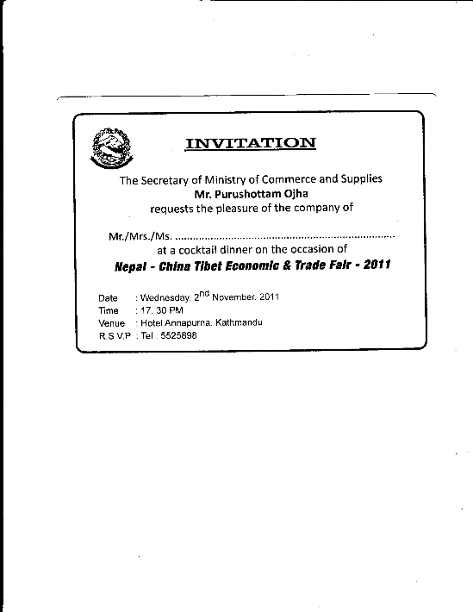
Invitation Sample

Slide 31
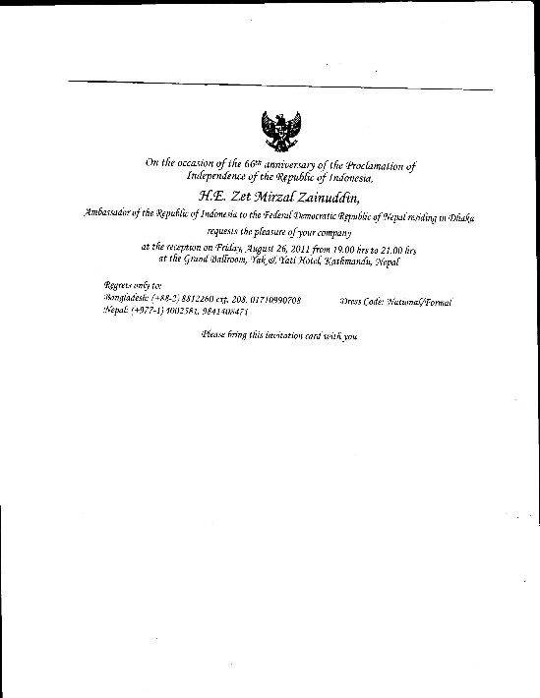
Invitation Sample 2

Slide 32
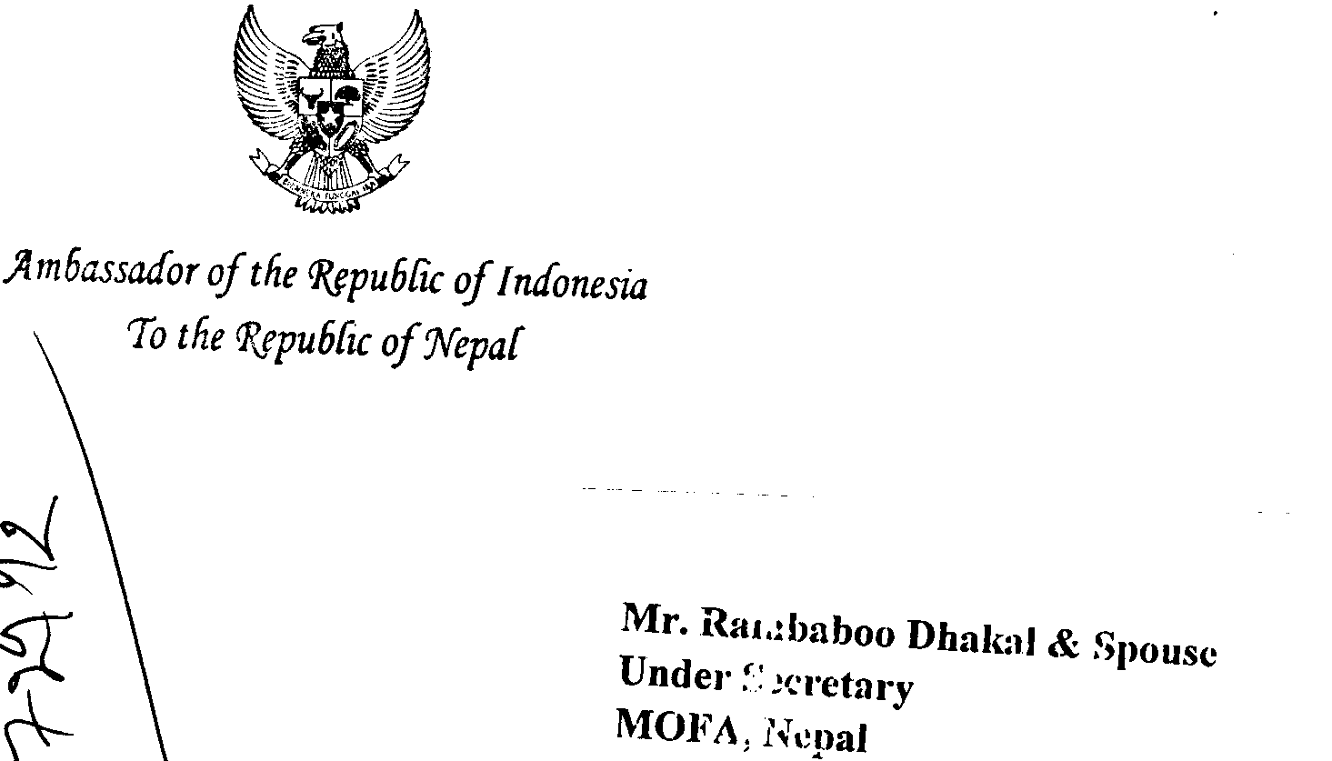
Envelop of Invitation Sample

Slide 33
Writing Exercise 10: Invitation
Suppose you are working in the Secretary’s office of your ministry. The Secretary would like to hold a reception to Ambassadors of major donor countries such as China, Japan, India, USA, UK and representatives of some funding agencies.
Prepare a draft invitation on behalf of the Secretary to the abovementioned guests.

Slide 34
Some Terms of Diplomatic Designations
Careful attention should be given to:
  Writing country's name
  Diplomatic designations (e.g., Ambassador Extraordinary and Plenipotentiary, Minister, Minister-Counselor, Counselor, First Secretary, Labor Counselor/Attaché, Second Secretary, Third Secretary, Attaché, etc.
  Similarly, consular positions (e.g., Consul-General, Deputy Consul-General, Consul, Vice-Consul, etc.
  Embassy/Consulate/Permanent Mission.

Slide 35
Terms
Diplomacy is a statecraft, skill and tact, technique to conduct foreign policy.
  Diplomacy is the management of international relations by ambassadors and envoys; the business or art of the diplomatist. (Oxford English Dictionary)
2. Foreign policy is briefly defined as "the sum of official external relations conducted by independent actor (usually a state) in international relations." (Changing Politics of Foreign Policy, 2003, P.3)
3. Accord : Synonym with "treaty".

Slide 36
Terms
4. Treaty : An international agreement between states in written form and governed by international law , whether embodied in a single instrument or more and whatever its particular designation. (Article 2, Vienna Convention on the Law of Treaties of 1969. Nepal is a signatory but not yet a party to the Convention.)
  -The term "treaty" is defined by the and Nepal Treaty Act, 2047, Section 2(a), as "an agreement concluded in writing between two or more states or between any state and any inter-governmental organization and document of this nature, irrespective of how it is designated."
  -A treaty creates legal rights and duties. It is concluded for matters of some gravity that require more solemn agreement.
5. Agreement : Agreement are less formal and deal with a narrower range of subject-matter than treaties.

Slide 37
Terms
6. Substitute words for treaty: "memorandum," or " protocol," or "exchange of notes," or "declaration," or "convention," or "charter," or "covenant," or "Act," or "statute," or "modus vivendi," or "agreed minutes,"etc.
7. Convention : is now generally used for formal multilateral treaties with a broad number of parties. It is normally open for participation by the international community or by a large number of states.
Protocol: The term is used for agreements less formal than those entitled treaty or convention.
Process-Verbal: is an instrument that contains a record of certain understandings arrived at by the contracting parties.

Slide 38
Terms
10. Declaration : is used for various international instruments. However, they are not always binding.
11. Memorandum of Understanding (MOU) : is an international instrument of a less formal kind. It does not require ratification.
12. Exchange of Notes: is a record of routine agreement. The agreement consists of the exchange of two documents, each of the parties being in the possession of the one signed by the representative of other.
13. Asylum: Granting of refuge. Diplomatic asylum means granting of refuge in diplomatic (or in consular) premises.
14. Casus Belli : An event or act which precipitates or is used to justify resort to war.

Slide 39
Terms
15. Diplomatic bag: A package which, to permit and protect free communication between a state and its diplomats, may not be opened or detained en route, whether it contains classified material or not. It must be sealed with the official stamp of the sending state or mission. It may be in the charge of diplomatic courier or diplomatic agent.
16. Capitulations : Privileges extended by the Sultan of the Ottoman Empire to foreign states for the benefit of their locally resident subjects. It is related to protection given to foreign envoys in Istanbul in the 18th century.
17. Diplomatic illness: An illness feigned (pretended) by a diplomat in order to avoid an official engagement.

Slide 40
Terms
18. Aide-Mémoire : An informal summary of diplomatic interview or conversation/call on that serves merely as an aid to memory. It is prepared without courtesy phrases and not signed.
19. Diplomatic privileges and immunities: The special legal position accorded to diplomatic agents by receiving states. Details of such privileges and immunities are given in the Vienna Convention on Diplomatic Relations, 1961. Privileges means tax exemption whereas immunities are referred to immunity from the jurisdiction of the receiving state private and criminal acts.
20. Consular Privileges and Immunities : are accorded to career consular officers. Details are given in the Vienna Convention on Consular Relations, 1963. Consular premises and documents are inviolable, as are consular communications.

Slide 41
Terms
21. Suo Motu : (Latin legal term) On its own motion. The government acted suo motu (on its own cognizance).
22. Démarche : Representation, individually or collectively, by one or more governments/ ambassadors, which may be views/suggestion on or protest/criticism against policy or action of the host government. It could be in the form of letter, aide-mémoire and non-paper).
23. Full powers: Powers granted by the government to negotiate, conclude and sign a treaty or an international agreement. The credentials prepared for a delegation to participate in the diplomatic or plenipotentiary meeting consists the full powers granted to the delegation to carry out the business connected with the session (meeting/conference).

Slide 42
Terms
24. Diplomatic Corps : refers to the heads of diplomatic missions and their staffs within a capital. The vehicles are assigned with the number plate as CD meaning Diplomatic Corps.
25. Special Envoy: A diplomatic agent/representative designated for a particular purpose for a temporary period.
26. Persona Non Grata (PNG): The process by which an ambassador or other diplomatic agent who is personally unacceptable to the receiving government is removed. Expulsion or request for recall of the diplomat, refusal to receive or to continue to receive the diplomat when a diplomat has personally offended the receiving state. The receiving state would request the recall of a diplomat and for the sending state to comply with such request (Art.9, VCDR).

Slide 43
Finally,
My sincere thanks for your kind attention !

